Slide 1

Anti Deepfake Detection : Real-time Analysis in Video Calls
Harnessing AI for Secure and Transparent Communication
Presented at Hackathon Summit 2025

Slide 2

The Challenge of Fake Media
The rise of misinformation in live video calls presents a growing challenge. It's difficult to identify mismatched facial expressions and deceptive audio in real-time. Existing video communication platforms lack the integration of advanced AI tools to combat this issue.

Slide 3

Introducing Deepfake Detection
1
Chrome Extension
2
Real-Time Detection
Analyzes live video calls.
Mismatches between facial expressions and spoken words.
3
Background Analysis
4
Alerts
Suspicious activity to ensure secure communication.
Powered by AI for enhanced situational awareness.

Slide 4





Cutting-Edge Features
Real-Time Detection
Facial Expression Analysis
Analyze video backgrounds for object detection.
Detect emotions and validate their match with spoken words.
User-Friendly Interface
Mismatch Alerts
Floating button for seamless integration into video calls.
Instant notifications for any discrepancies.

Slide 5

Technology Overview
Frontend
APIs
JavaScript, HTML5, CSS3
Google Cloud Vision, TensorFlow.js, Web Speech API
Browser Extension
AI Models
Chrome Manifest V3 compatibility
Pre-trained models for facial and sentiment analysis

Slide 6
How It Works
Step 1
1
User activates the extension during a video call.
2
Step 2
Real-time video and audio streams are captured.
Step 3
3
AI models analyze facial expressions and match them with speech.
4
Step 4
Background objects are identified using Google Lens.
Step 5
5
Alerts are shown for mismatches or suspicious activity.

Slide 7



Real-World Applications
Secure Video Calls
Education
Customer Support
Business meetings, legal consultations.
Verify student engagement during remote classes.
Authenticate user emotions during calls.

Slide 8
What's Next?
Improved Accuracy
1
Advanced AI models.
Multilingual Support
2
Multiple languages and platforms.
App Integration
3
Popular video conferencing apps like Google Meet and Teams.
Enhanced Security
4
Privacy and security measures.

Slide 9
Meet the Team
Developers
Special Thanks
[Prabhu Yengde , Lilesh Nimkar , Hemant Kadukar]
Hackathon Summit organizers and mentors.

Slide 10
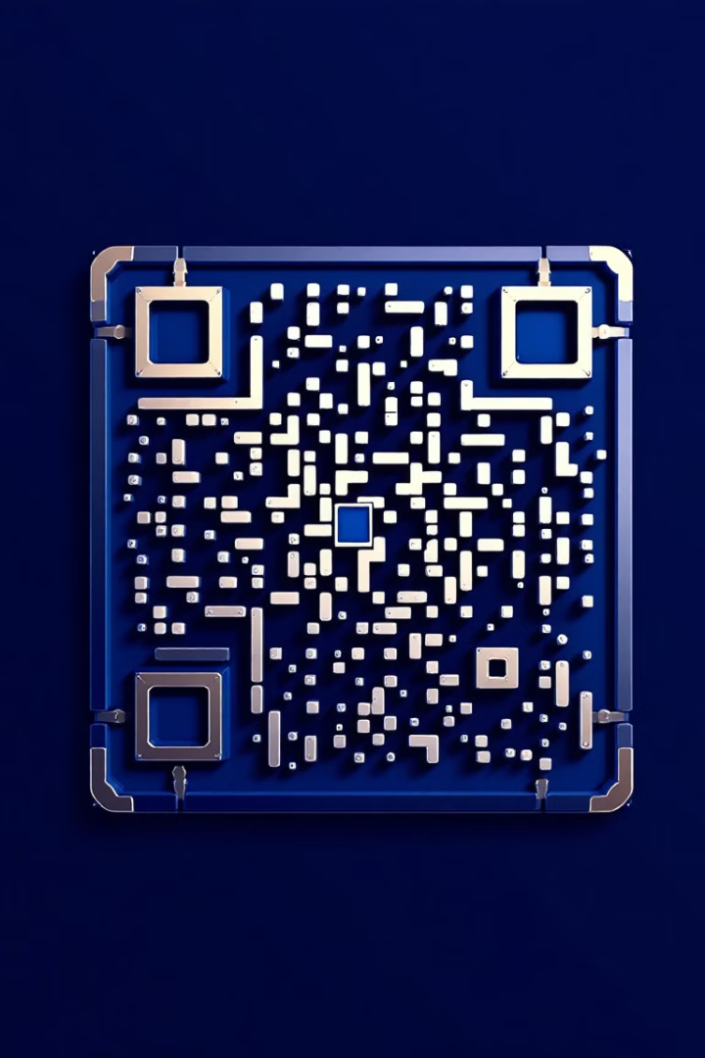
Thank You!
Try the demo and experience the future of secure communication!
Contact Info: Email, social media links.

